Slide 1

CSCI910/410
Software Requirements, Specifications and Formal Methods
Week6 Tutorial

Slide 2

Exercise 3
Draw a Finite State Machine (FSM) for the project. Please also complete the state table.

Slide 3
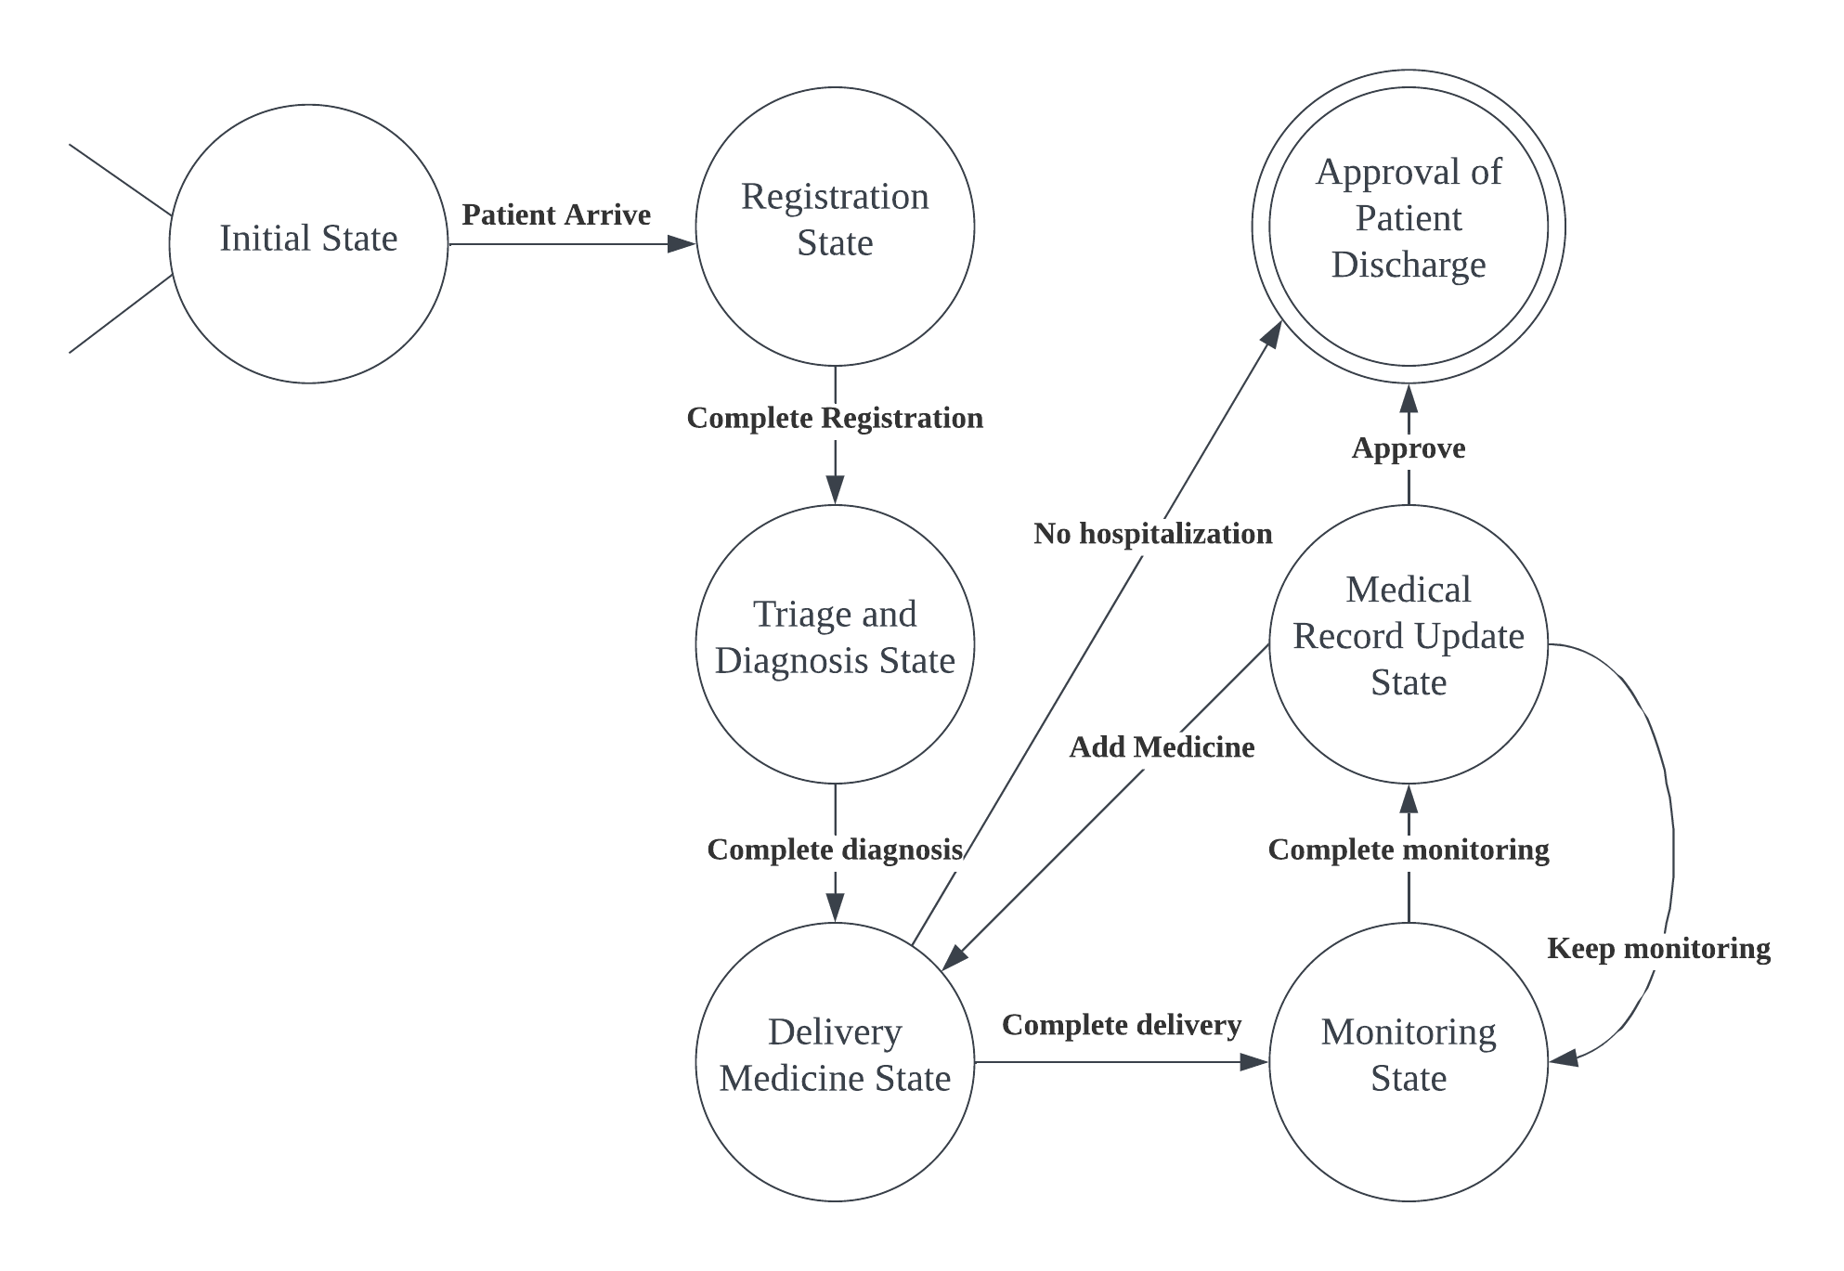
FSM Example

Slide 4
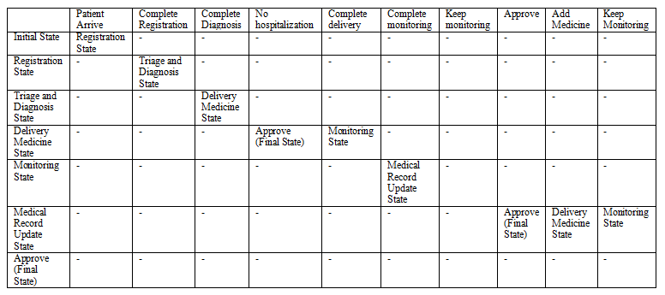
State Table Example

Slide 5
THANKS

